Slide 1
London to Madrid
The value of going back home

Slide 2


Slide 3
How much?
When is the right time?
From where?
Can we predict prices?

Slide 4
How much?
When is the right time?
From where?
Can we predict prices?

Slide 5
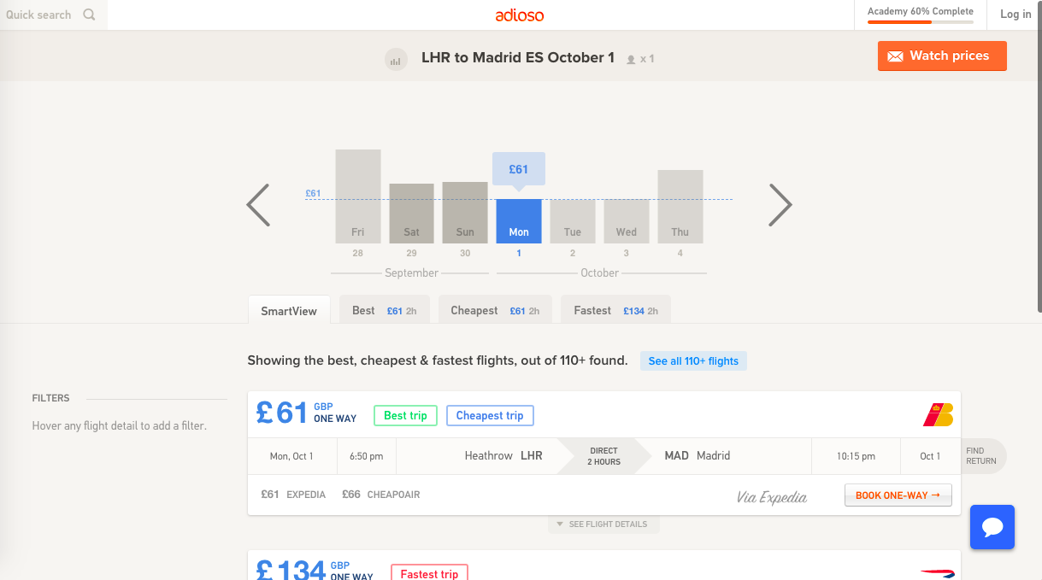

Slide 7





LHR
LTN
LGW
STN

Slide 8
Scraping: 1st September
September not included
August not complete
British Airways duplicates

Slide 9
cheapest airport?

Slide 10
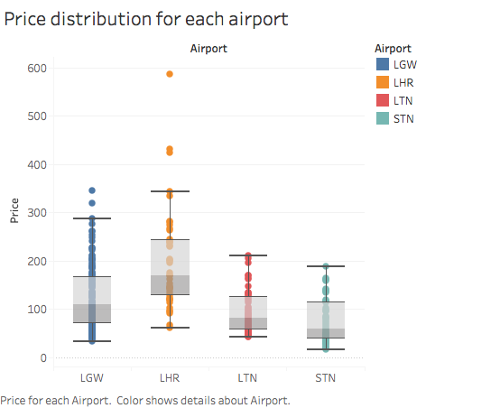

Slide 11
cheapest month?

Slide 12
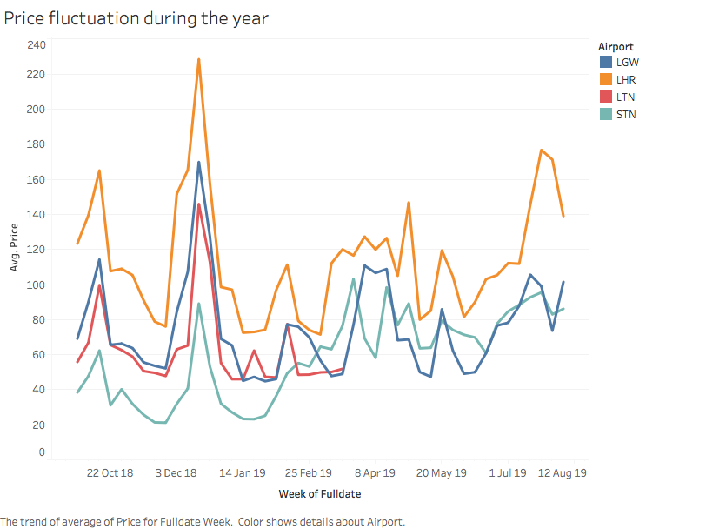

Slide 13
cheapest day of the month?

Slide 14
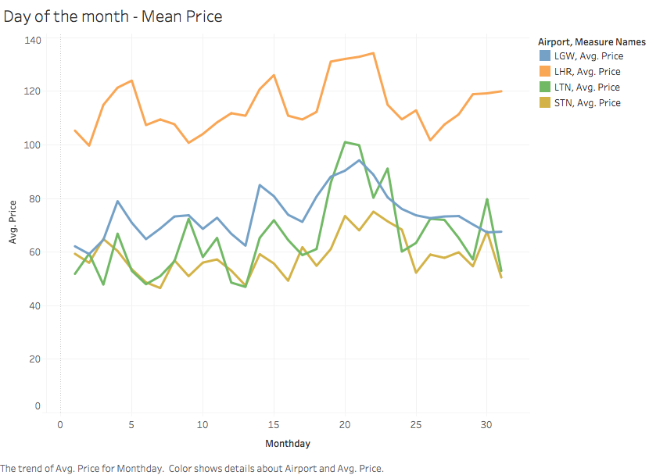

Slide 15
cheapest day of the week?

Slide 16
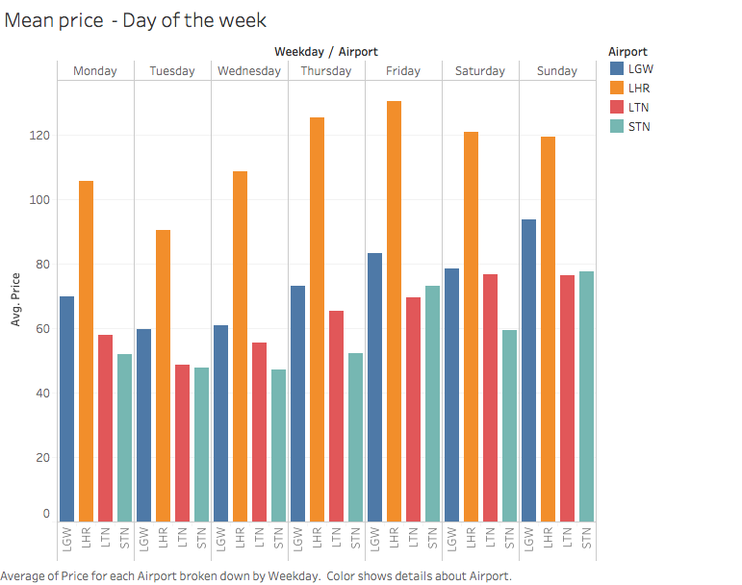

Slide 17
cheapest airline?

Slide 18
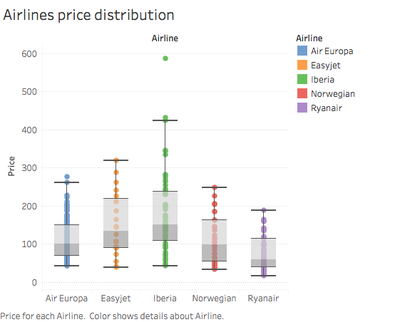

Slide 19
what is a deal?

Slide 20
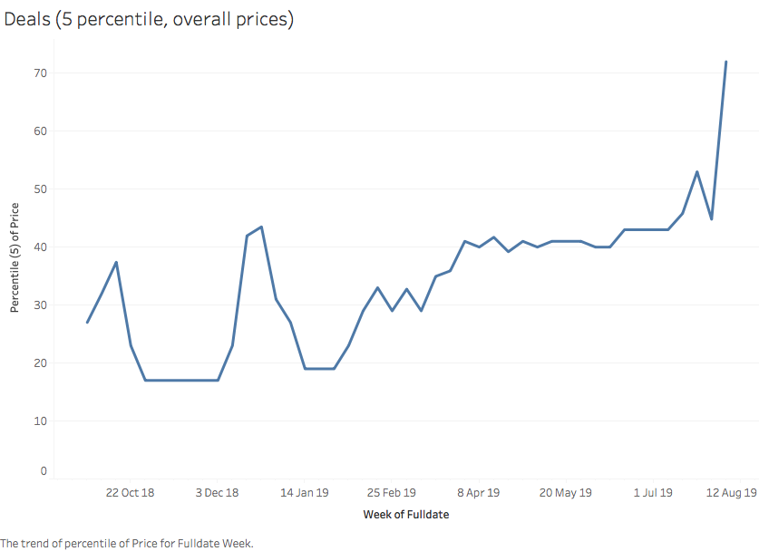

Slide 21
How much?
When is the right time?
From where?
Can we predict prices?

Slide 22
Predicting the price of one specific flight

Slide 23
LHR
LTN
LGW
STN

Slide 24

Predicting the price of one specific flight
Other flight prices
Month
Day of the month
Day of the week

Slide 25

Predicting the price of one specific flight

Slide 27

Problem:

Slide 28
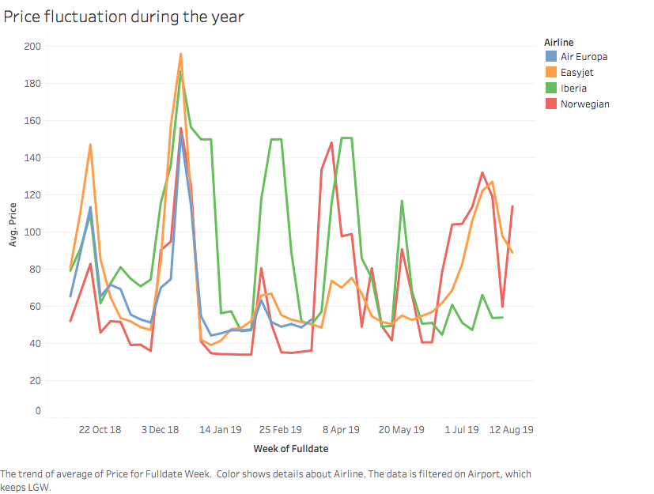

Slide 29
2. Predicting the cheapest daily price for Air Europa

Slide 30

2. Predicting the cheapest daily price for Air Europa

Slide 31
Next steps

Slide 32
Seasonality
Scraping prices from the past
Add weights to the prices

Slide 33

github.com/jacobovarela

